Slide 1
Python for everybody
Prepared by
Siddharth s s
sriramsiddharth19@gmail.com
www.linkedin.com/in/siddharth-s-s-916409164

Slide 2
Introduction to python
Python is a high-level, interpreted scripting language developed in the late 1980s by Guido van Rossum
Python is a very simple programming language so even if you are new to programming, you can learn python without facing any issues
Interesting fact: Python is named after the comedy television show Monty Python’s Flying Circus. It is not named after the Python snake

Slide 3
Why python?
There are many programming languages to choose, but why python?
Popularity – over the last few years python has been growing in a rapid phase
Survey – stack overflow developer survey of 2018 ranked python as the 7th most popular and the number one most wanted technology of the year
Due to its popularity and widespread use, python developers are sought after and well paid

Slide 4
Features of python
EASY TO LEARN
ADVANCED FEATURES
OPEN SOURCE
FEATURES
EXCEPTION HANDLING
READABLE
INTEGRATED
MANY LIBRARIES
CROSS PLATFORM

Slide 5
EASY TO LEARN - LEARNING PYTHON IS EASY. IT IS EASY TO UNDERSTAND AS IT DOES NOT HAVE COMPLECATED SYNTAX
OPEN SOURCE - PYTHON IS OPEN SOURCE AND FREE TO DOWNLOAD
READABLE - python is a very readable language
Integrated - it can be integrated with languages likes c, c++, java etc.

Slide 6
cross platform - Python can run of various operating systems such as windows, mac, linux, unix etc.
Many libraries - python has many inbuilt libraries that has many handy functions which can be used while writing code
Exception handling - an exception is a python object that represents an error. When a script encounters a situation that it cannot cope with, it raises an exception
Advanced features - supports generators, list comprehension etc.

Slide 7
What can be done using python?
Scripting - Scripting is writing small programs to automate simple tasks such as sending automated response emails. Such type of applications can also be written in Python programming language
Web development – Web framework like Django and Flask are based on Python. They help you write server side code which helps you manage database, write backend programming logic, mapping urls etc.

Slide 8
Machine learning – There are many machine learning applications written in Python. Machine learning is a way to write a logic so that a machine can learn and solve a particular problem on its own. For example, products recommendation in websites like Amazon, Flipkart, eBay etc. is a machine learning algorithm that recognizes user’s interest
Data Analysis – Data analysis and data visualization in form of charts can also be developed using Python
Game development – You can develop games using Python

Slide 9
How to Install Python?
You can install Python on any operating system such as Windows, Mac OS, Linux/Unix and others
To install the Python on your operating system, go to this link: https://www.anaconda.com/distribution/

Slide 10
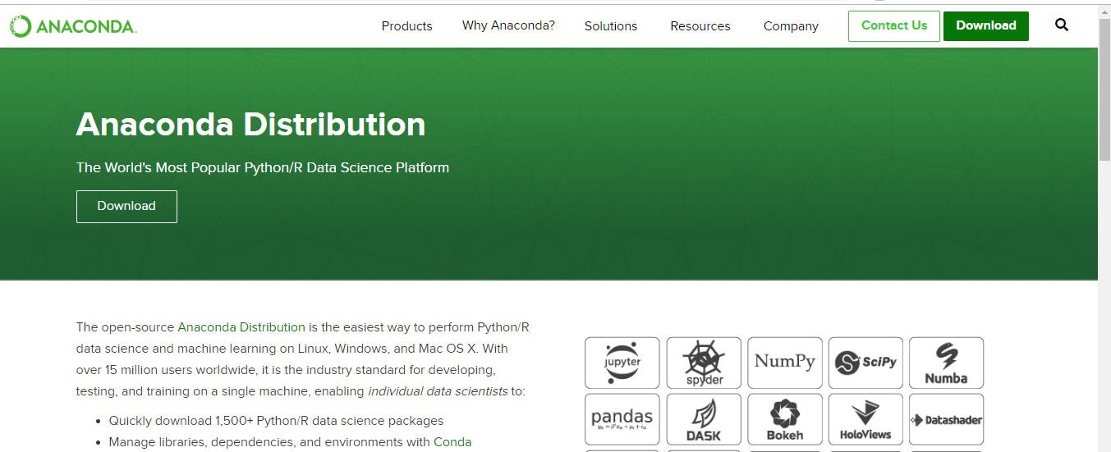
You will see a screen like this, click on download

Slide 11
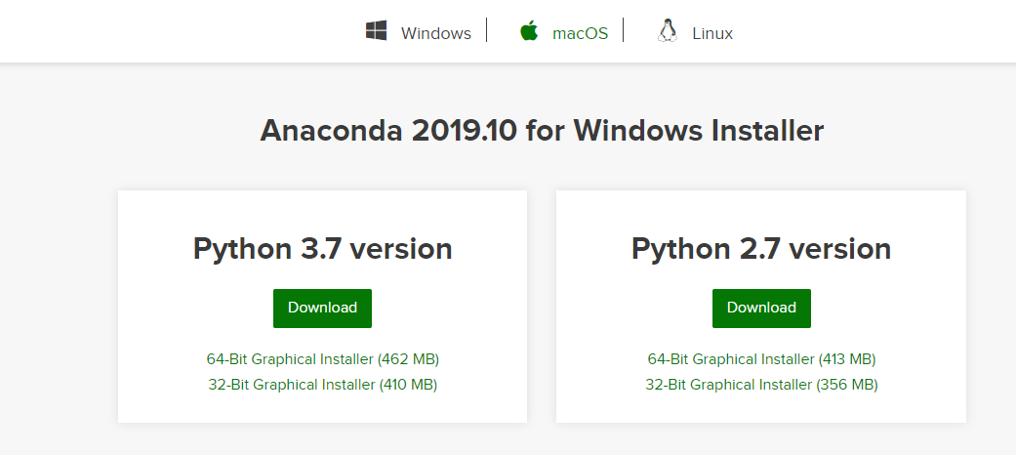
Choose your operating system(windows, macos, linux), click on 64-bit graphical installer - download the latest version that is available
if your system has 32 bit processor then download 32-bit graphical installer

Slide 12
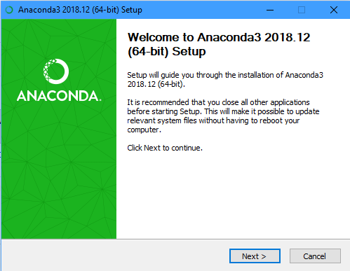
Go to the folder where the downloaded file is available, double click on the file
Click next

Slide 13
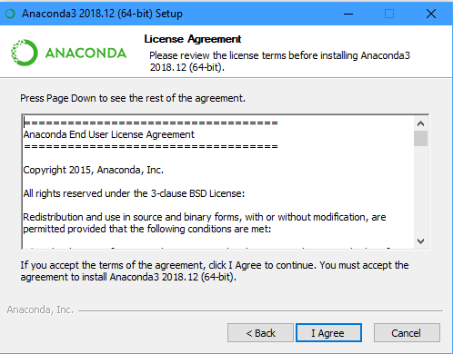
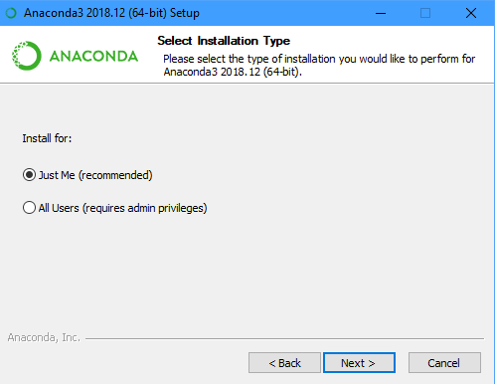
Click i agree Click just me or all users and press NEXT

Slide 14
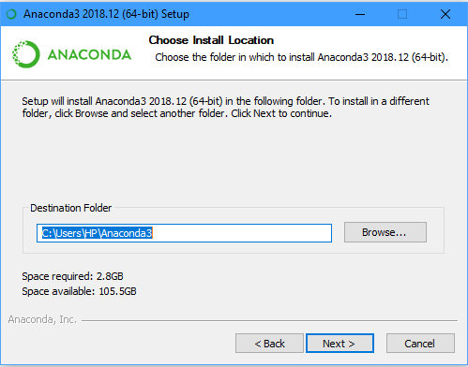
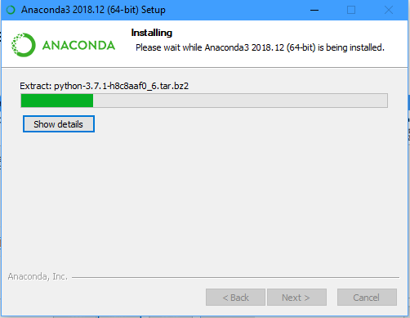
Browser the folder where you would the installation will start, it may take
like to install the software(empty folder) a while to complete(5 – 10 mins)

Slide 15
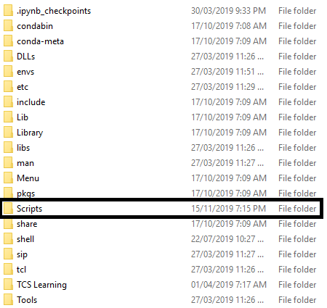
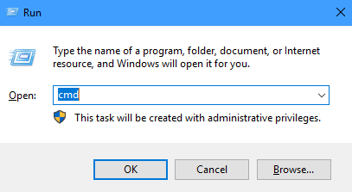
Go to the installed location click click windows + r, type cmd to open a scripts folders command prompt

Slide 16
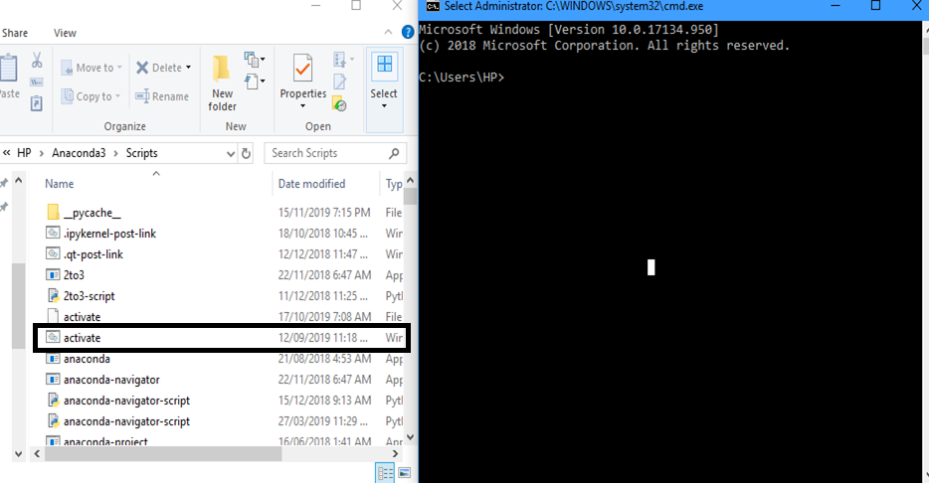
reduce the file explorer and command prompt size, drag and drop the activate file in command prompt, click on the command prompt and press enter

Slide 17
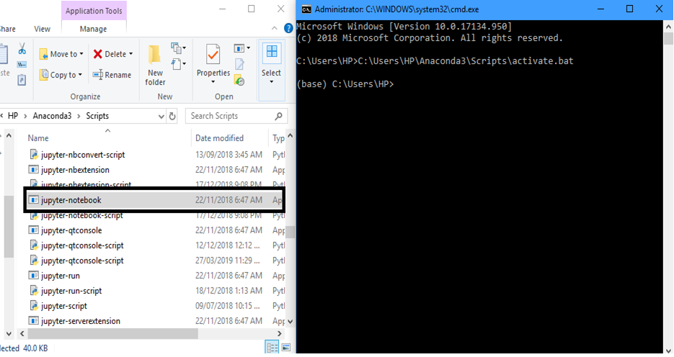
Scroll down in the scripts folder locate jupyter-script drag and drop the file in the command prompt, click at the end of bat and click enter

Slide 18
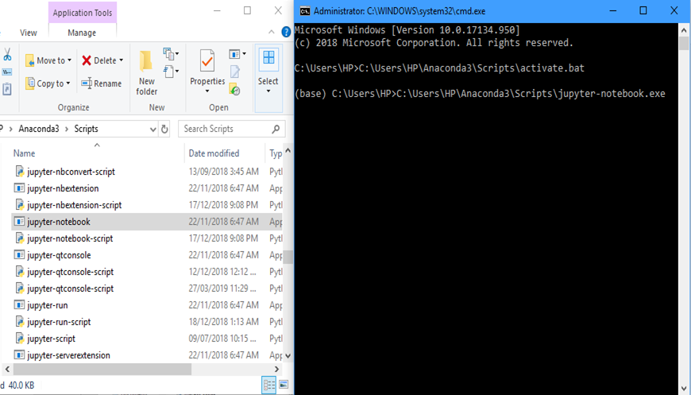
Go to command prompt click enter, it takes few seconds for certain scripts to run, then automatically jupyter notebook gets opened in a browser

Slide 19
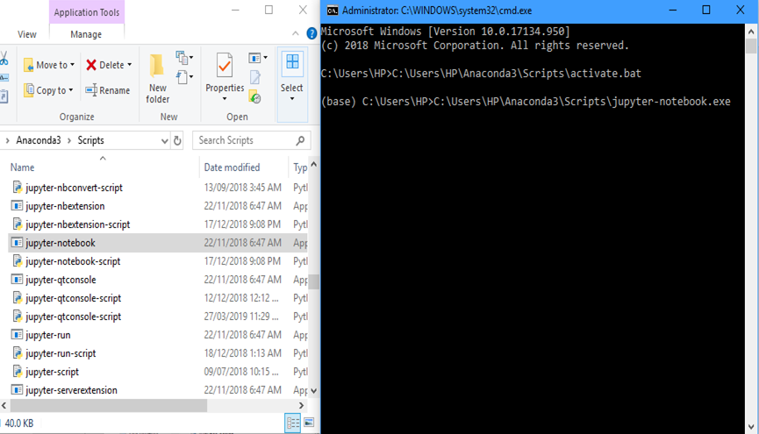
Go to command prompt click enter, it takes few seconds for certain scripts to run, then automatically jupyter notebook gets opened in a browser

Slide 20
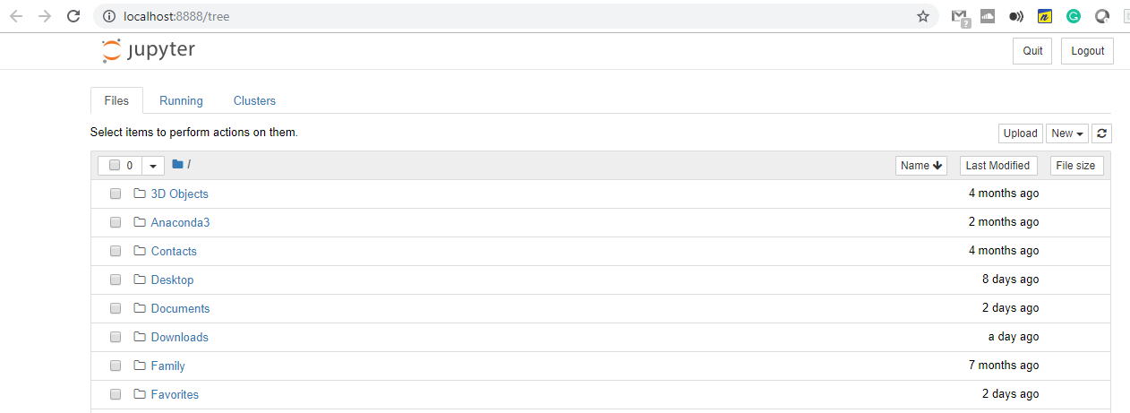
You could see a similar page opened in a browser

Slide 21
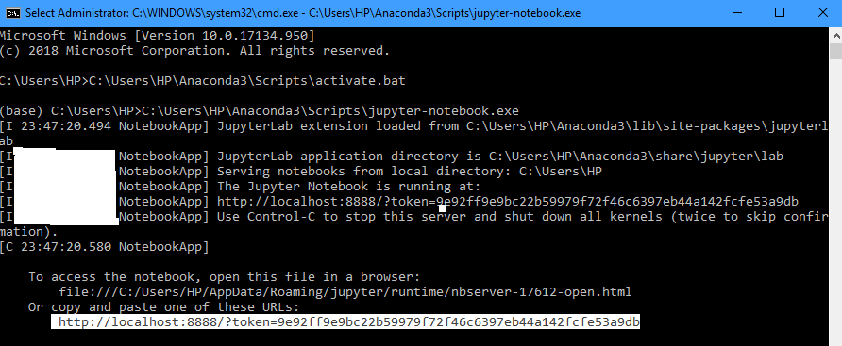
Suppose if the page is opened in any other browser and you want to open it in your favourite browser, go to the running command prompt copy the url in the last line and paste in your favourite browser and click enter

Slide 22
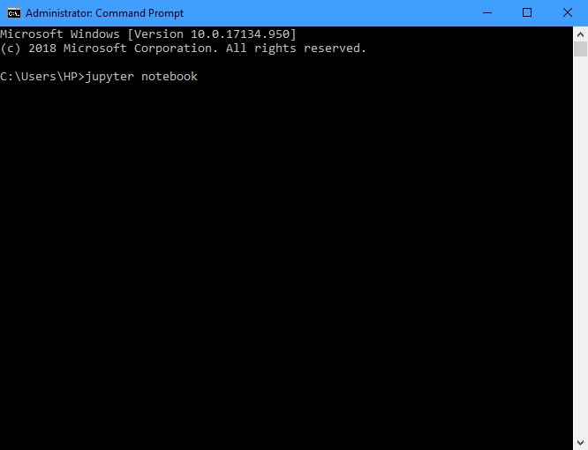
The above are one time process. From the very next time on, open a command prompt just type jupyter note book and press enter

Slide 23
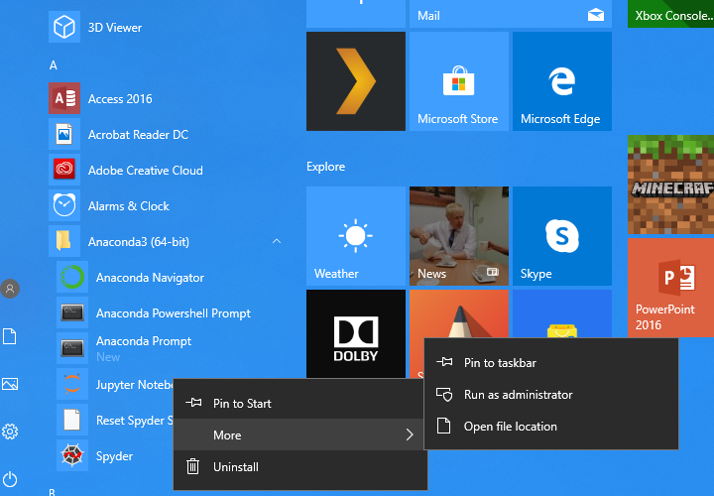
Suppose if you feel the previous step of opening the jupyter notebook requires much effort. you could pin jupyter notebook to taskbar.
Go to all programs – click anaconda – right click on jupyter notebook – hover on more – click pin to taskbar

Slide 24
Mac os also has a couple of ways to pin your most used item in our case jupyter notebook to the dock:
Drag the program file or folder icon to the dock and wait for the icons in the dock to move to make room for the new icon. To remove it from the dock, just drag it off of the dock
you could also pin an application, open by right-clicking its icon on the dock and selecting Options - Keep in Dock
If you find some folders, like the Applications folder, won't stick to the dock, create an alias which you can add to the dock: right click on the folder and select Make Alias, then drag the alias to the dock

Slide 25
Now that we are ready with our software.
Why to wait?
Let us start coding python

